Slide 1
SIMF Example: Group Marriage in Manyland CDM with a Mapping to an Abstraction of EMF for Business to Illustrate a Methodology and Tooling for Specifying Information and Generating Editors for SIMF Models note: illustrations of the tooling are shown in a basic notation, graphic, expression , and other editors/views may be added
1/8/2013
zenie@montages.com

Slide 2
Methodology : A (meta) Modeling Process using Abstracted EMF Tooling
Agile testing and iteration of models with concrete examples
EMF + OCL abstracted as MCore simplifies and automates model derivation and construction with best practice and usability extensions
Models may be quickly tested, changed, and retested in a workflow that includes generation and transform steps
Domains are modeled in, or mapped to, MCore:
MCore is an abstraction of EMF + OCL for modeling business concepts and properties
MCore provides a roundtrip QVTo mapping to EMF ECore which, itself, has mappings to UML, eMOF, and XML Schema – others, if needed, may be added
Domains may be core languages, such as the SIMF kernel, CDMs, LIMs, MBRs and any domain required for semantic federation. The domain models may have meta relationships
MCore generates editors for the models specified in it
The generated editors enable model instance definition in tables, expression tools, etc. while the model retains the capability to add/modify notation as needed in its editor generation
For example, Eclipse GMF (Graphical Modeling Framework) may be added to the generation configuration to generate graphical views and editors
If the information specified in the generated editor is intended as meta to other models or objects (note: bridging abstraction levels is hard but doable with an ECore base):
Using QVTo, or other Model to Model mechanisms, map the information defined in its generated editor to MCore
Generate an editor from the mapped to MCore and continue repeating this process until complete, there may be n meta levels

Slide 3
Methodology : Iteration and Composition
Iteration to Derive, Refine, and Evolve Models
Define Examples, extend and evolve as needed
Derive a Model for expressing the Examples
Specify the Derived Model in a modeling tool and generate an editor for testing it with the Examples
From the testing results refine the Model as needed and generate a new editor for testing the Examples with the modified Model
Repeat from previous step until complete
Composition of Separate Concerns expressed in separate Models in the context of other Domain Models
Assume a Library of Domain Models, e.g., Group Marriage, Address, Person
Define a new domain model, e.g. an event in a community such as a marriage, that uses these Domain Models via Relationships, e.g., :
Community isA Group Marriage (Generalization, implies a Group Marriage generated Editor) for specifying Members of the Community
Member isA Person (Generalization, Member Editor defined by Person generated)
Person Associated with Address via UML-like Association or EReference

Slide 4
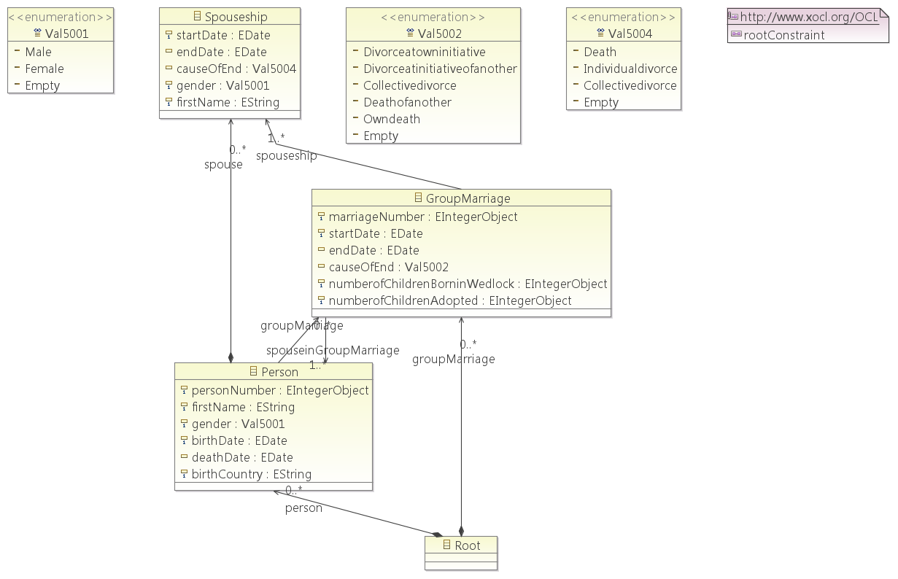
Initial Mapping Diagram in ECore (Generated from the MCore to follow)

Slide 5
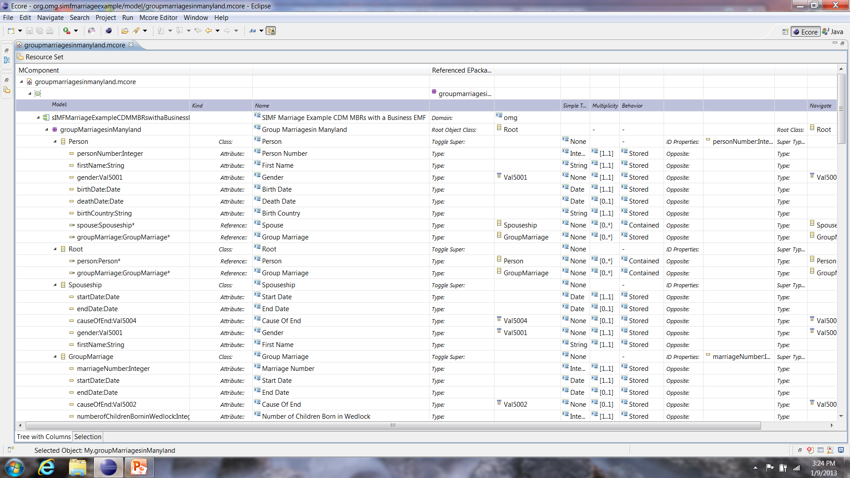
Group Marriage Example CDM Mapping, via UML, to MCore (1)

Slide 6
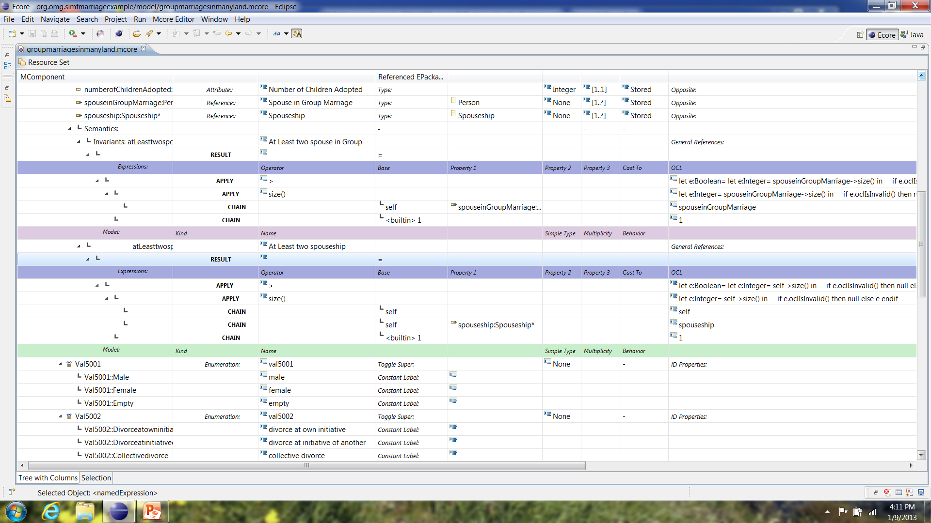
Group Marriage Example CDM Mapping, via UML, to MCore (2)

Slide 7
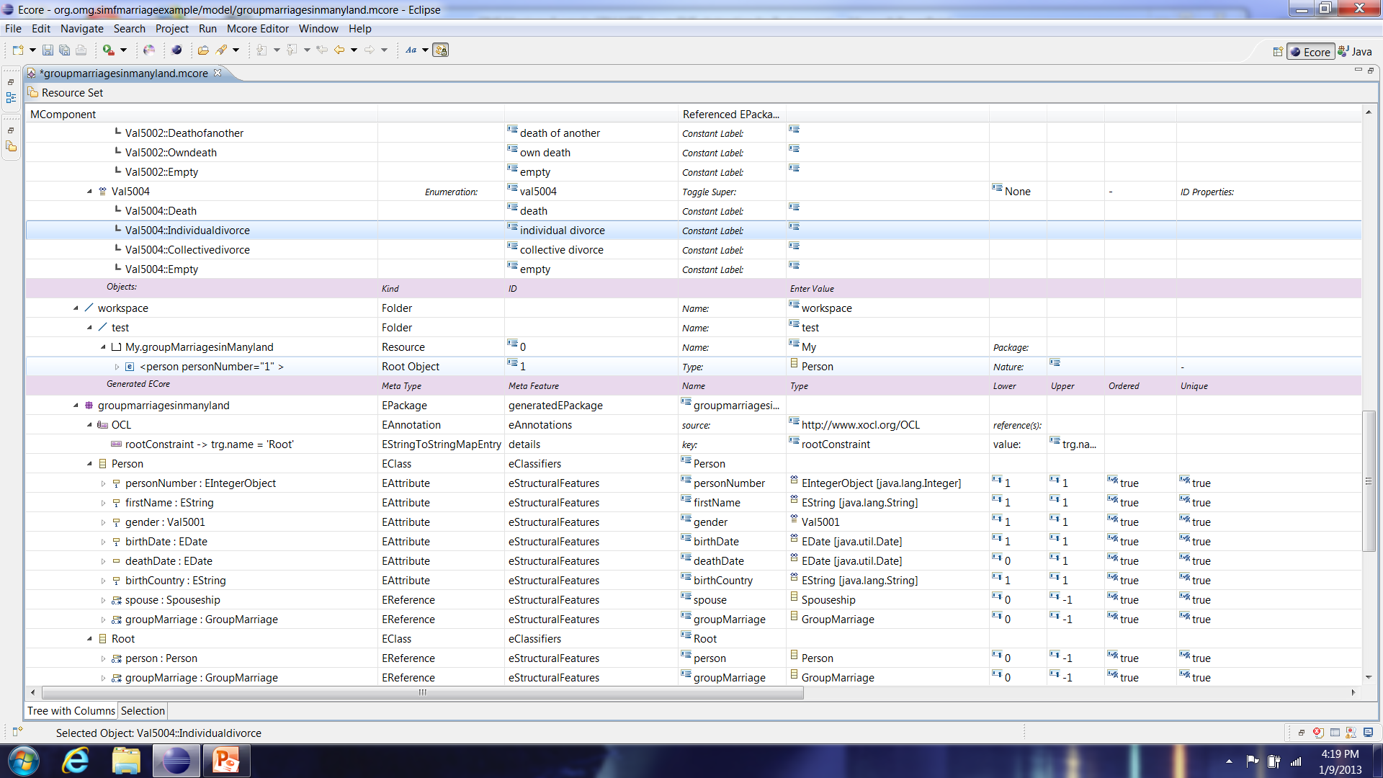
Group Marriage Example CDM Mapping, via UML, to MCore (3)

Slide 8
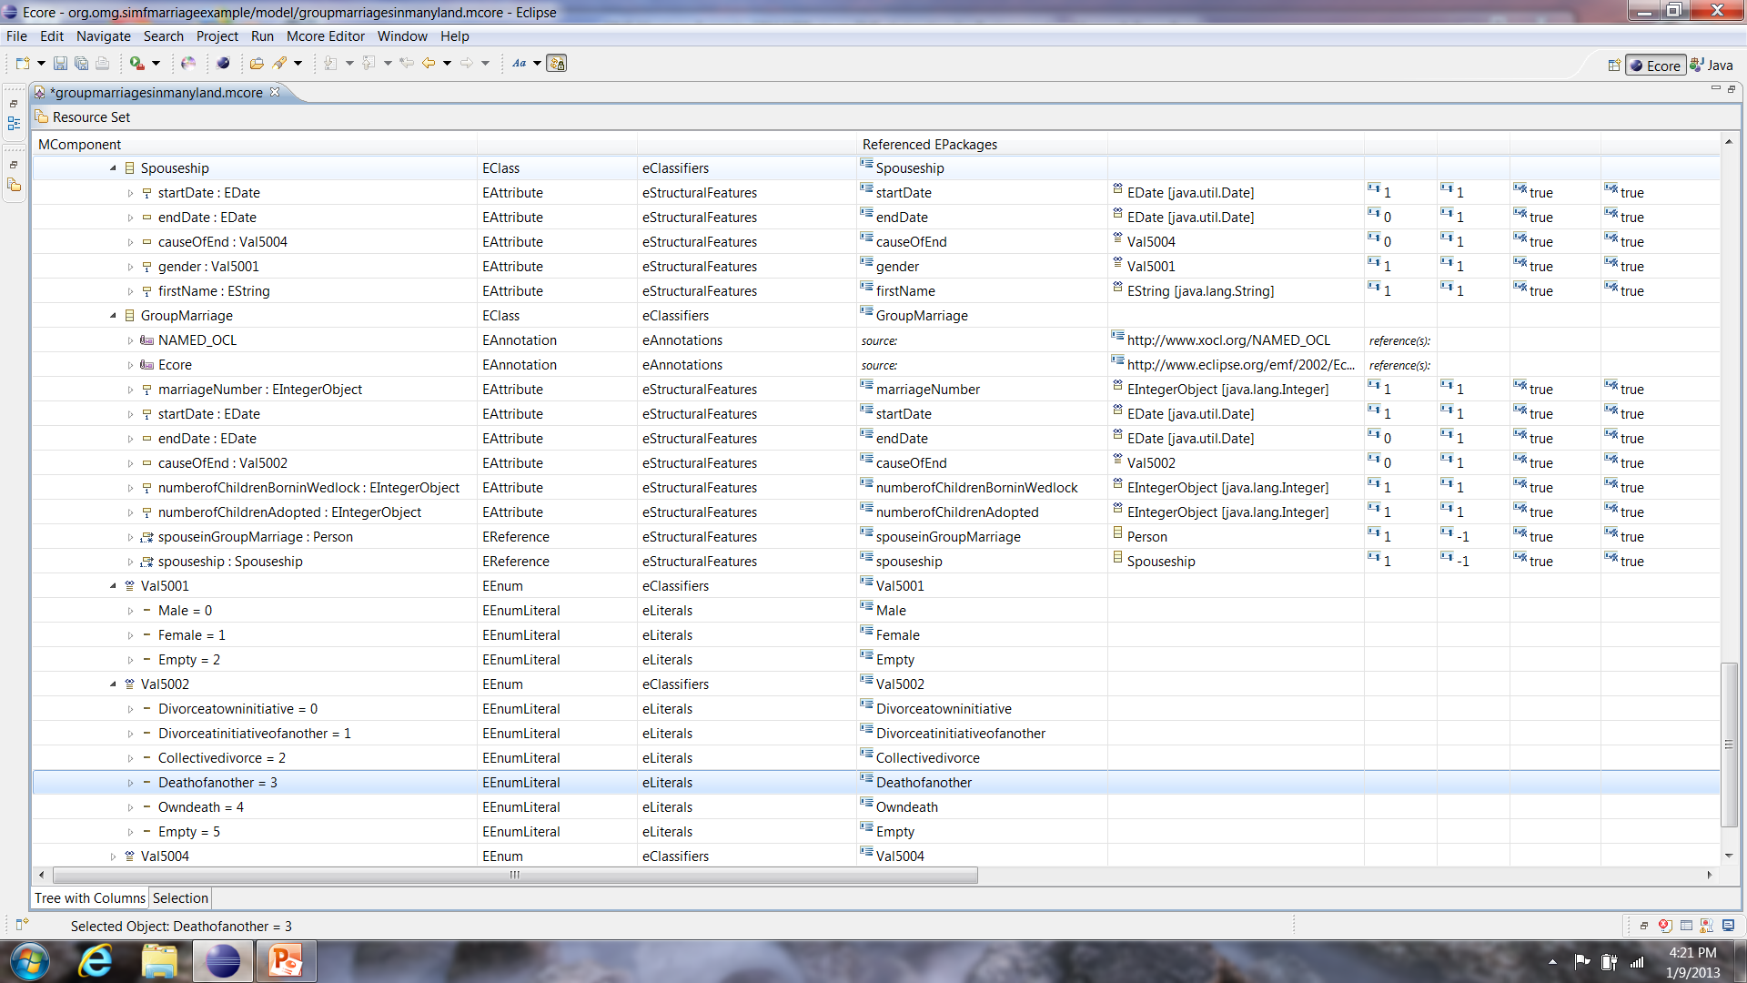
Group Marriage Example CDM Mapping, via UML, to MCore (4)

Slide 9
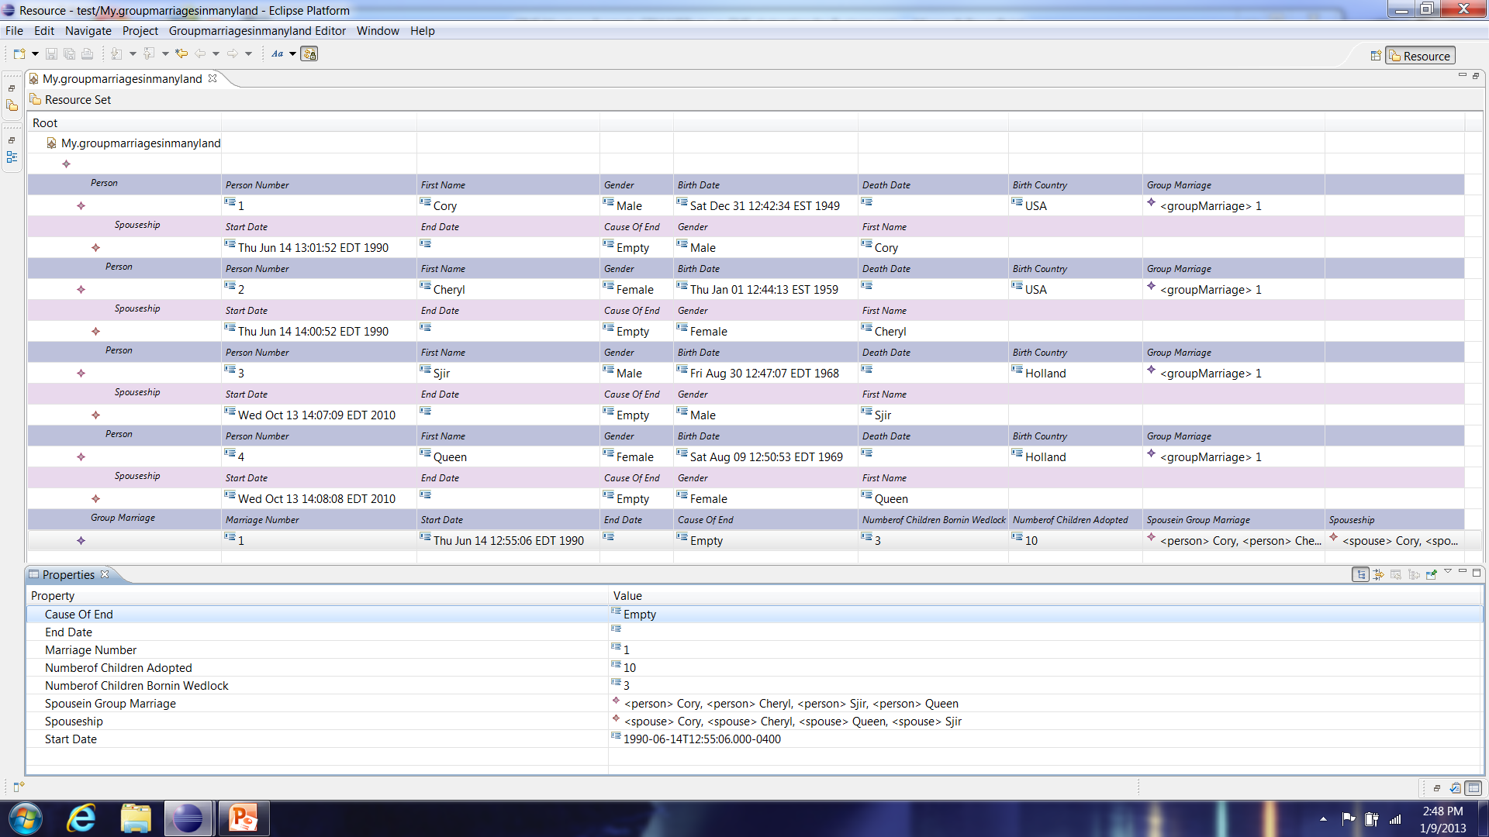
Editor Generated from Group Marriage CDM, via UML, mapped to MCore and Populated with a Very Simple Example

